Slide 1

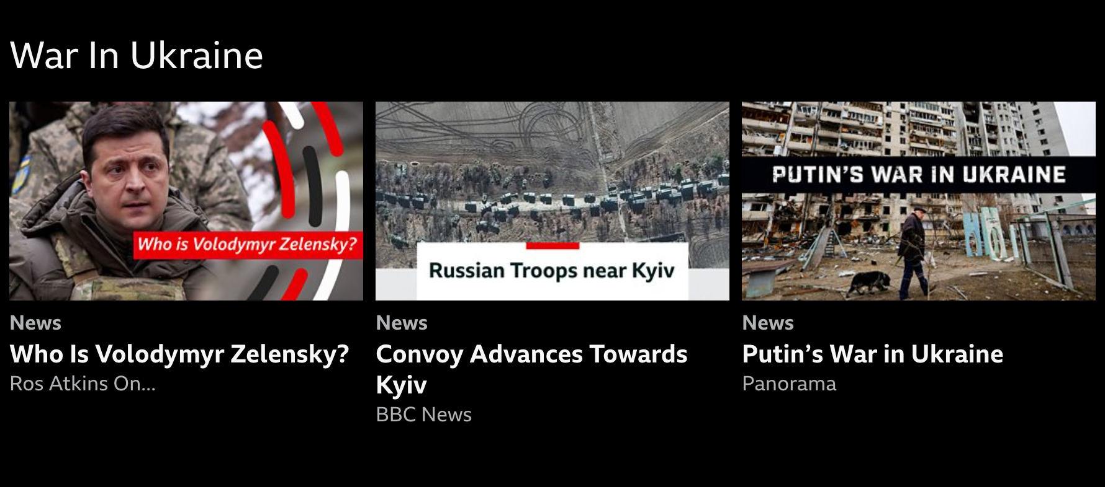
Viewers of “Ukraine” content on iPlayer
Vicky Banks
Data Science
March 2022

Slide 2
Key Information
Content was located
Homepage rail
BBC News Channel page
Non-personalised
Dates:
2022-02-25 to 2202-03-03
Excluding 2202-03-01
How many items?
Length of content?

Slide 3
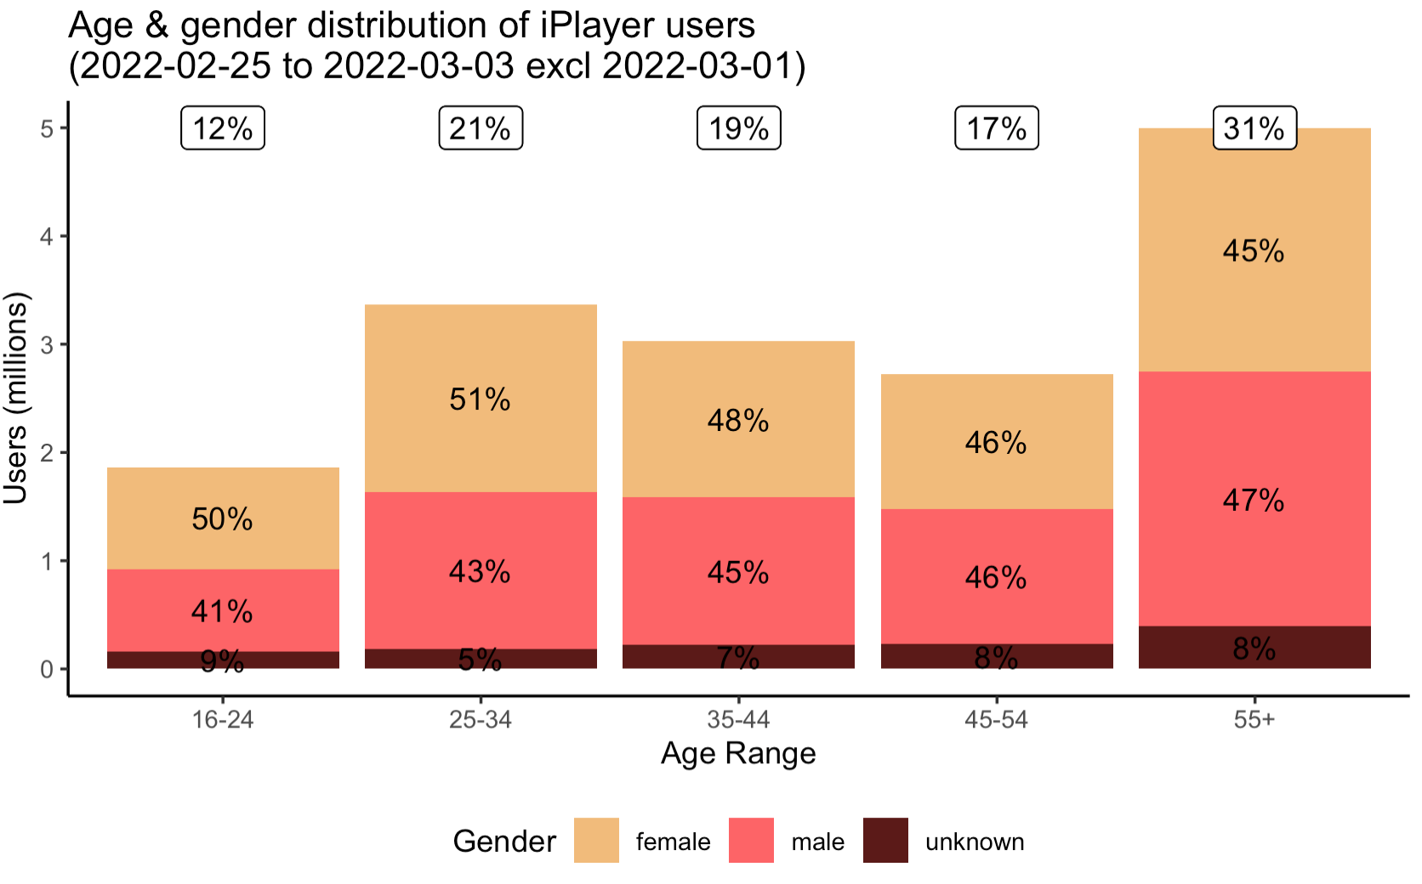
All iPlayer
17mil users over the 5-day period.

Slide 4
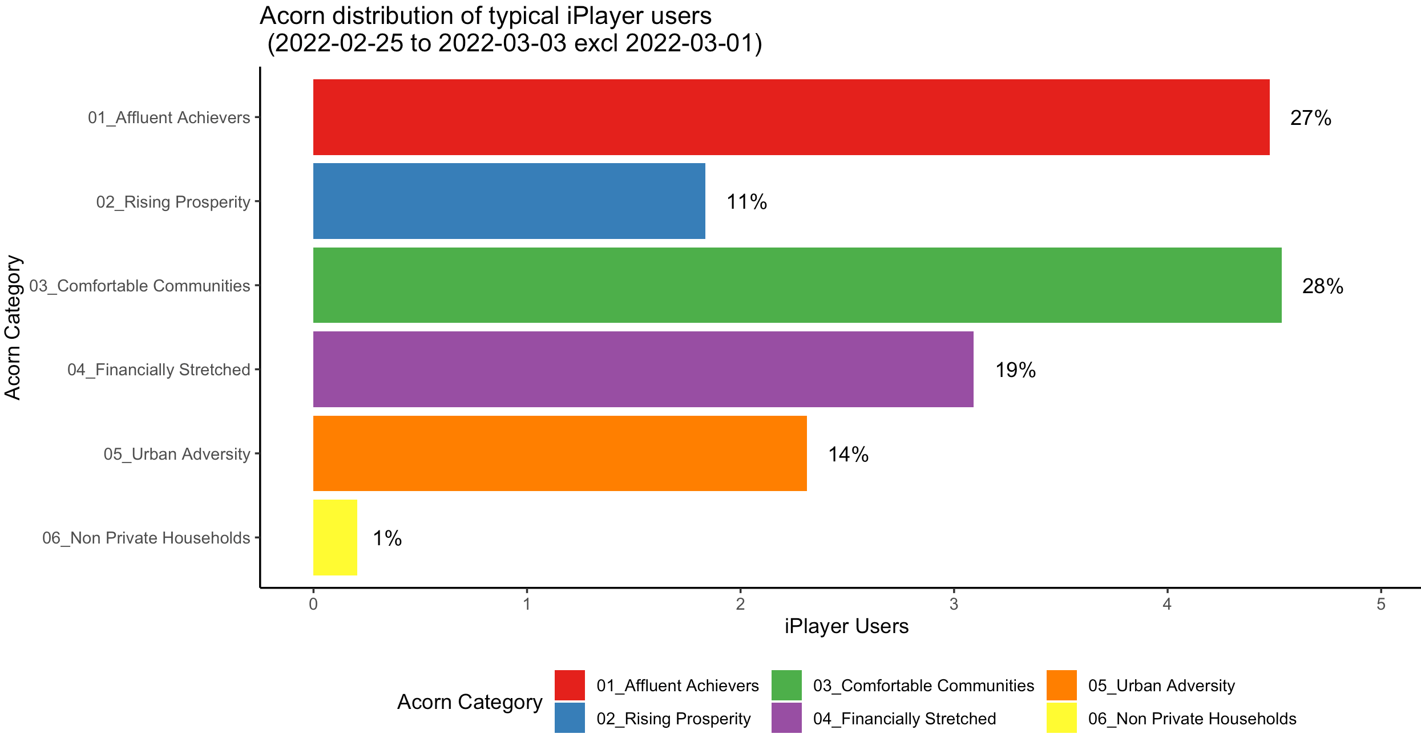
All iPlayer
17mil users over the 5-day period.

Slide 5
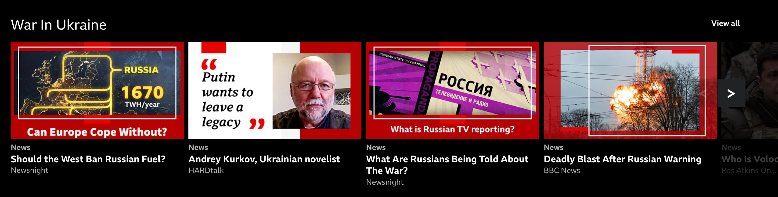
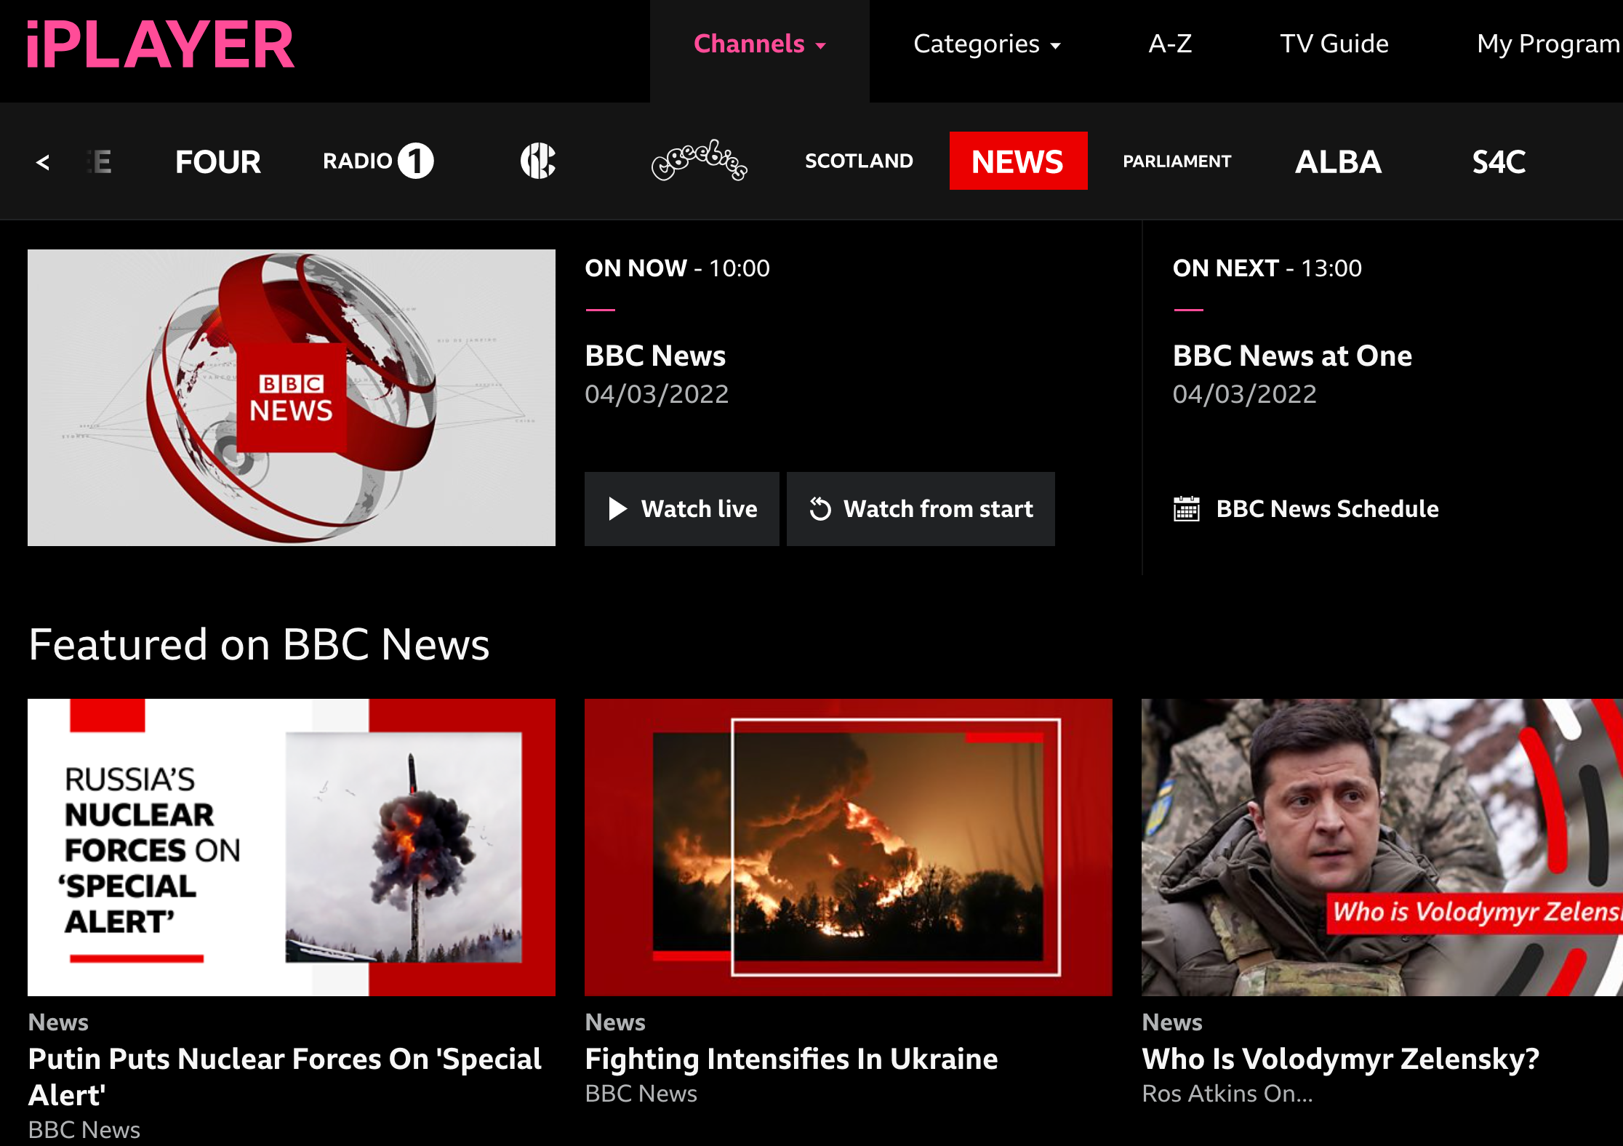
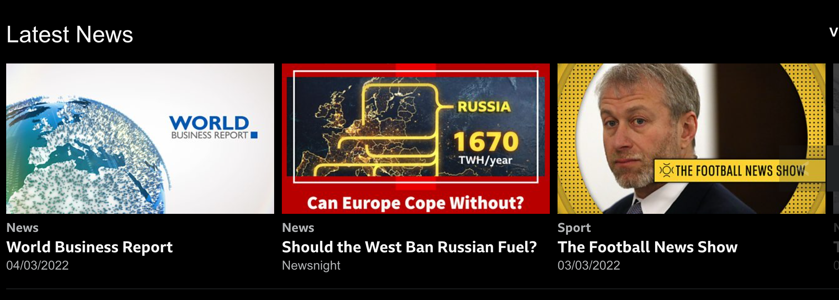
Ukraine Audience
150k users over the 5-day period who clicked on any item in a Ukraine rail
iPlayer home – tv/mobile/web
BBC News Channel page.
News Category Page
But this content can be found in other areas.

Slide 6
BBC News has seen over 27m requests on BBC iPlayer. The vast majority were for live news
IPLAYER REQUESTS TO NEWS
MOST REQUESTED PROGRAMMES ON DEMAND

Slide 7
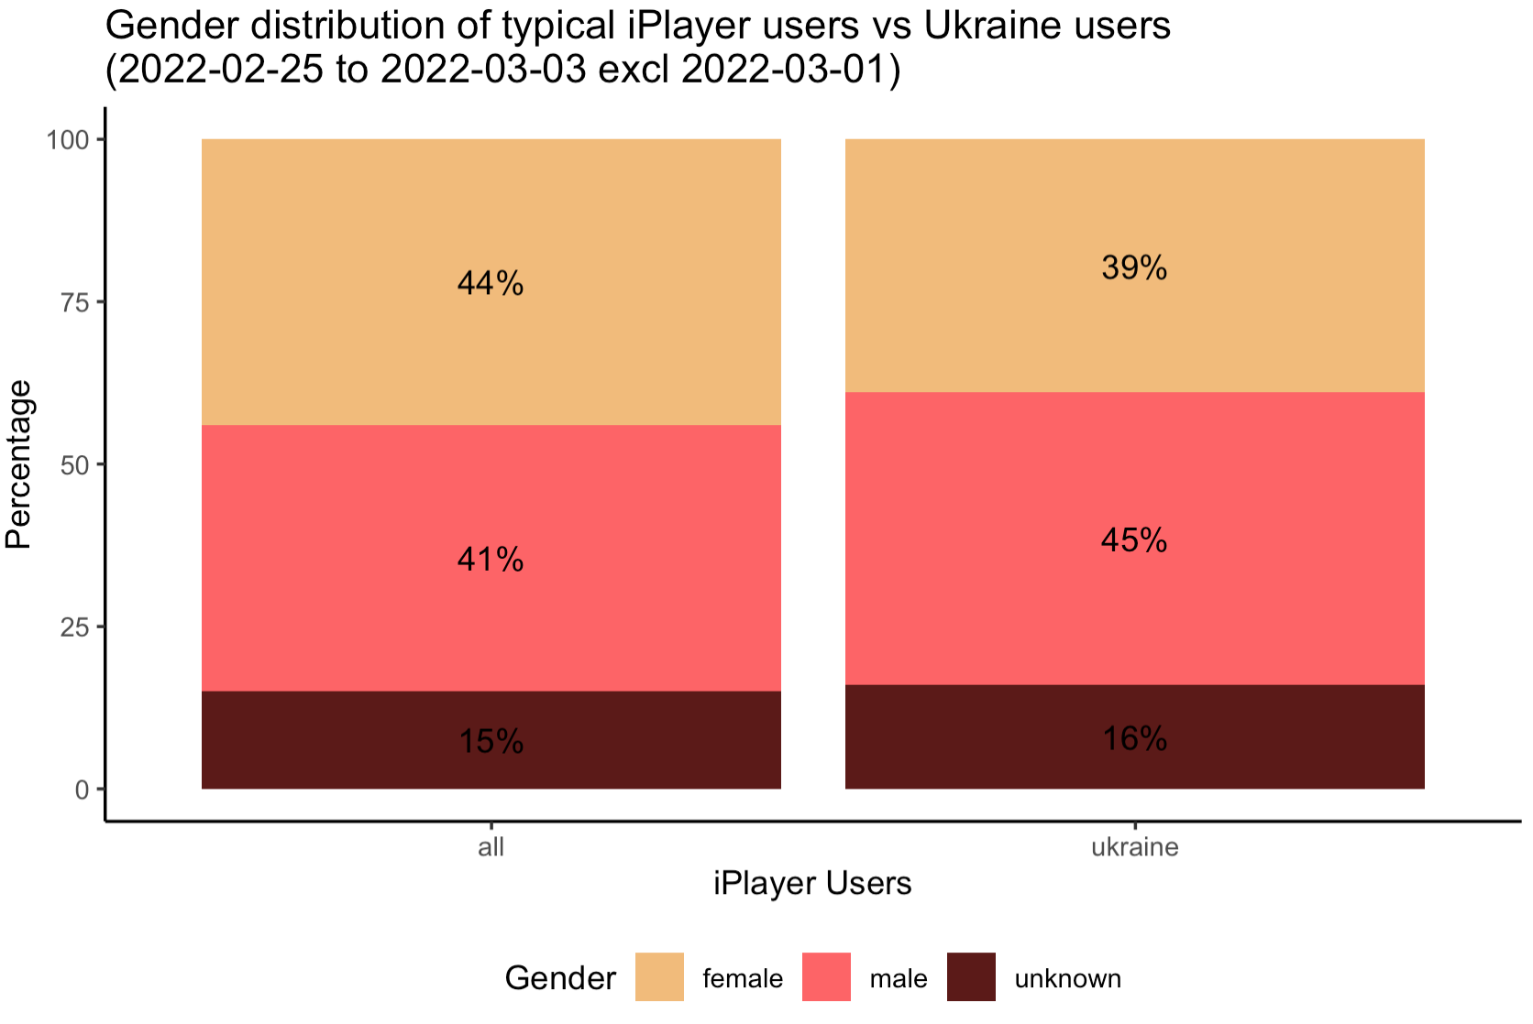
Ukraine Audience
150k users over the 5-day period who clicked on any item in a Ukraine rail

Slide 8
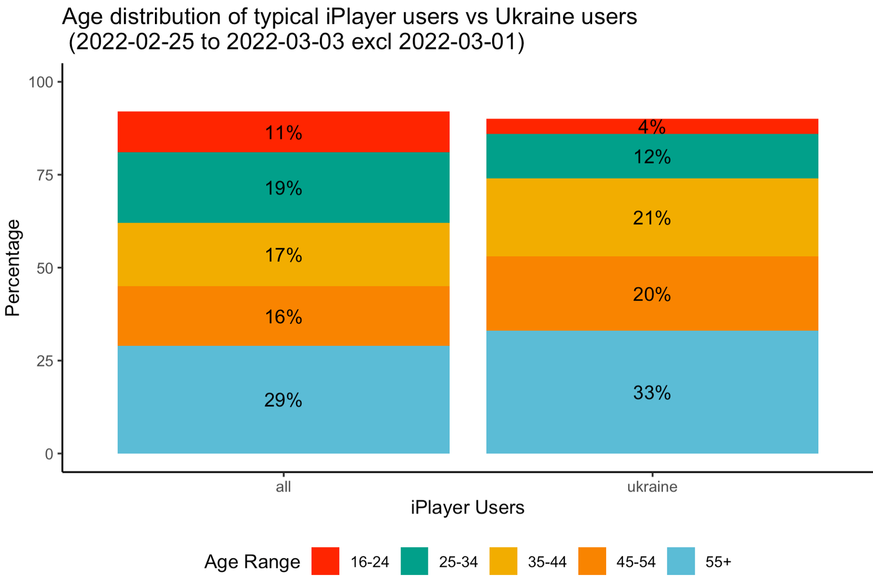
Ukraine Audience
150k users over the 5-day period who clicked on any item in a Ukraine rail

Slide 9
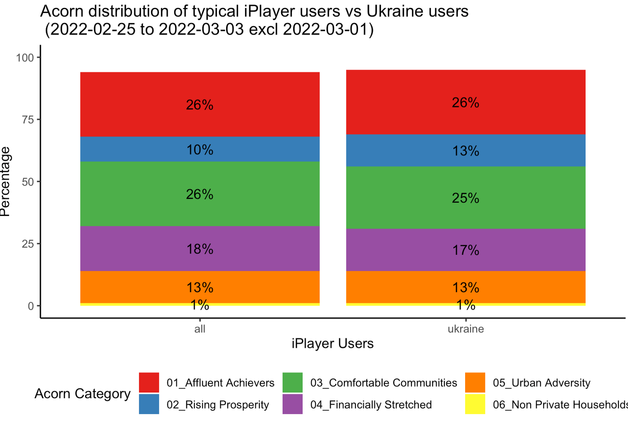
Ukraine Audience
150k users over the 5-day period who clicked on any item in a Ukraine rail

Slide 10
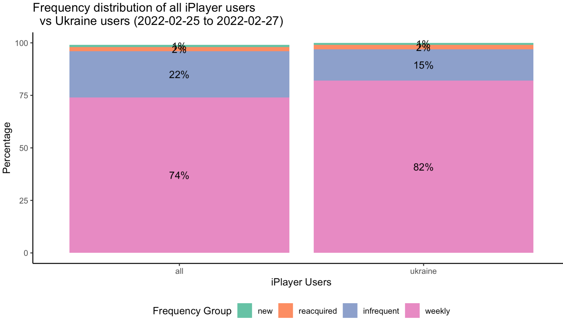
Ukraine Audience
150k users over the 5-day period who clicked on any item in a Ukraine rail

Slide 11
Ukraine Audience - Summary
150k users
Slightly male skewing
Slightly older skewing, very few 16-24s
Typical acorn demographics
More likely to be weekly users
A typical BBC heavy user audience, with a slight older, male skew.

Slide 12
Finding Content on iPlayer
Location | Clicks | Starts (30s) | Completes (90%)
Episode page (autoplay) | 51% | 63% | 66%
Homepage | 35% | 33% | 31%
Channels | 6% | 1% | 1%
Categories | 3% | 2% | 2%

Slide 13
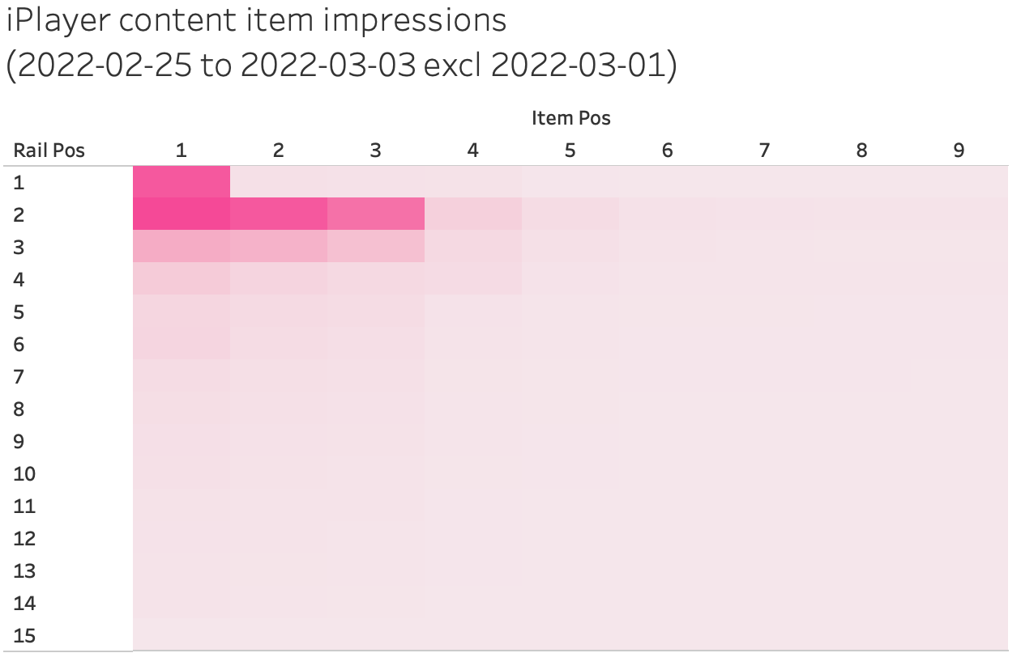
Finding Content on iPlayer

Slide 14
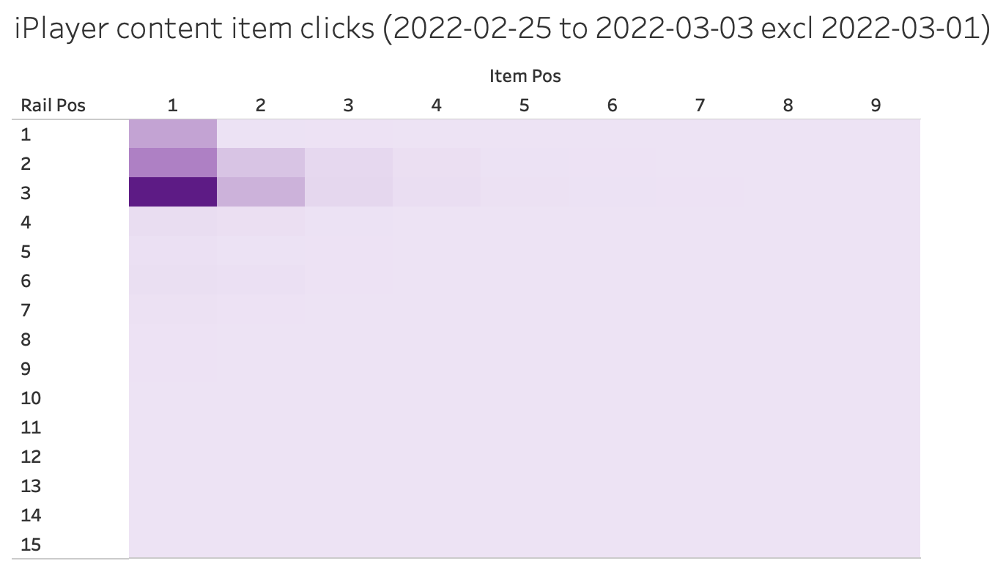
Finding Content on iPlayer
Ukraine Rail

Slide 15
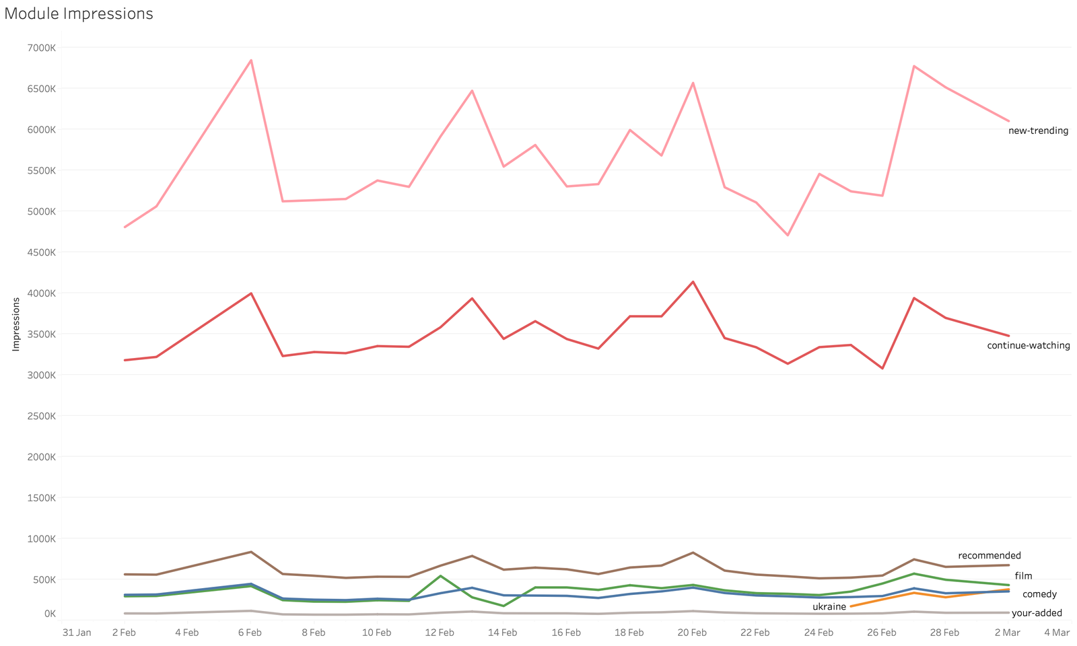
Viewers seeing the content
Ukraine Rail

Slide 16
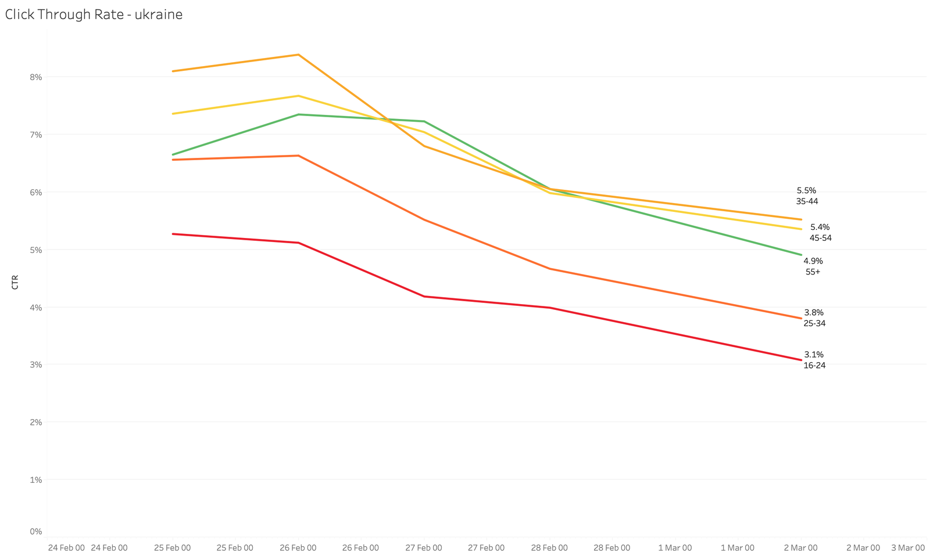
Click through rate
CTR is poor
Higher than comparatively positioned ”comedy”
Higher CTR for 35+ (~5%)
Lower CTR for 16-34 (~3%)

Slide 17
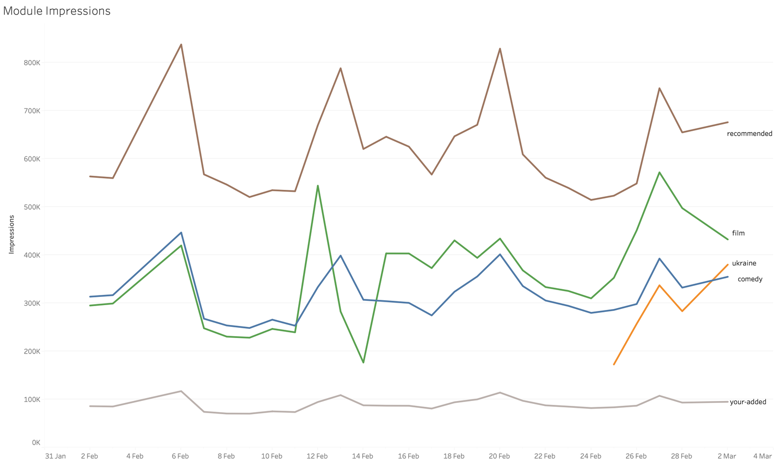
Viewers seeing the content
Ukraine Rail
200k – 400k per day
Notes:
The difference for CTR per age range is consistent with other rails on iPlayer, the same for mobile/tv/web. Mobile is also more typically older audiences.

Slide 18
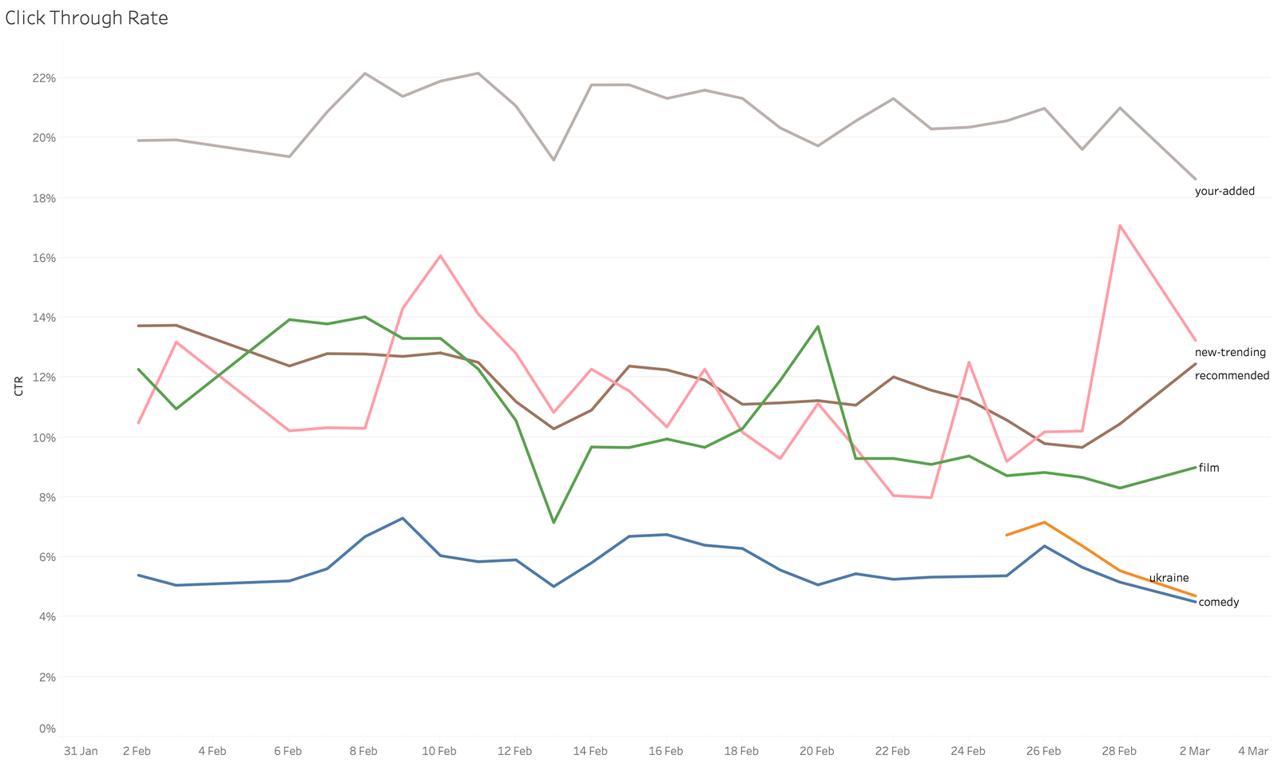
Viewers seeing the content
CTR is poor,
Higher than comparatively positioned ”comedy”
Higher CTR for 35+ (~5%)
Lower CTR for 16-34 (~3%)
Higher CTR for mobile (~5%)
Ukraine Rail
200k – 400k per day
Notes:
The difference for CTR per age range is consistent with other rails on iPlayer, the same for mobile/tv/web. Mobile is also more typically older audiences.

Slide 19
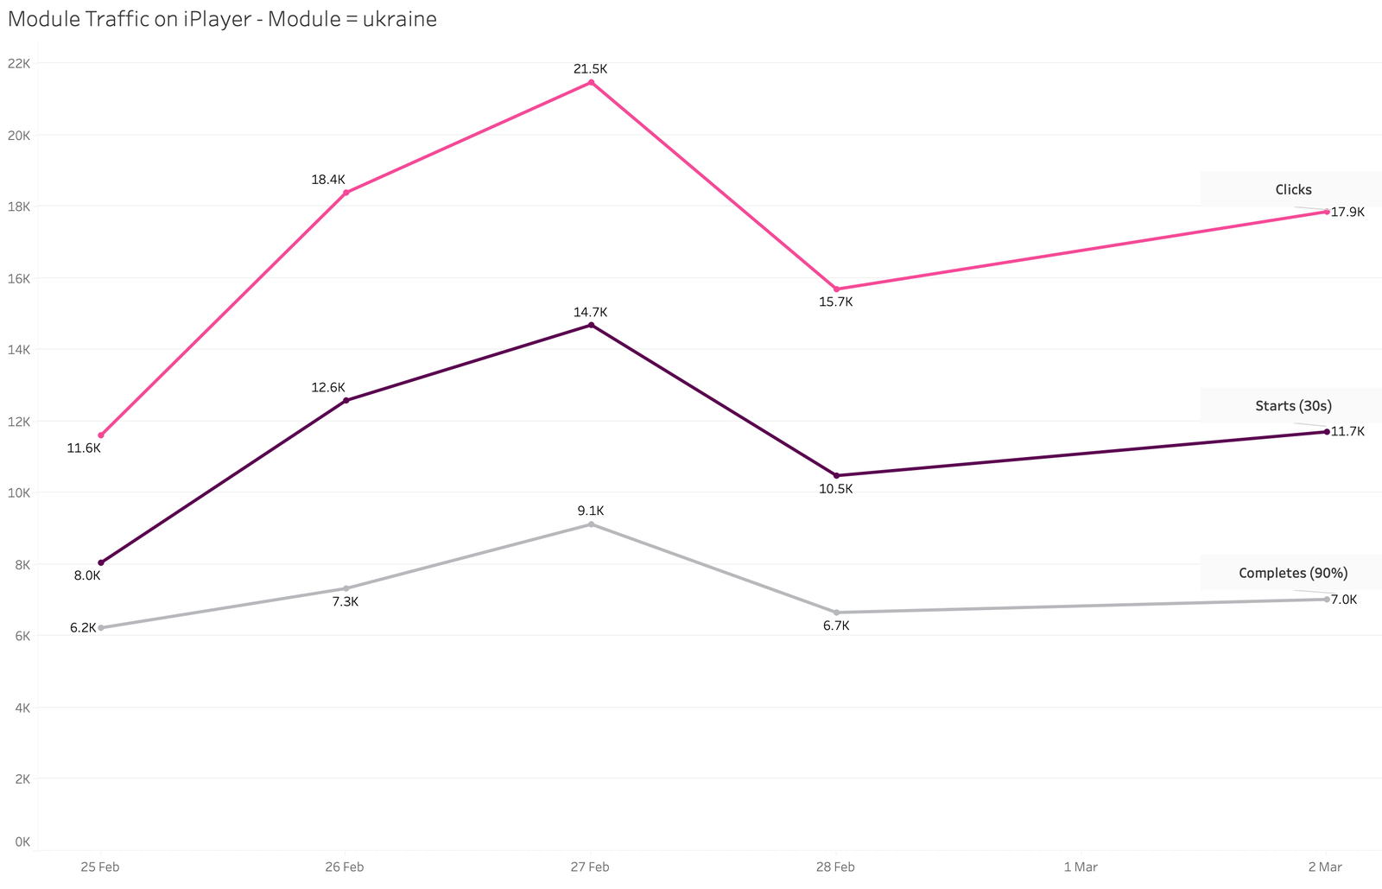
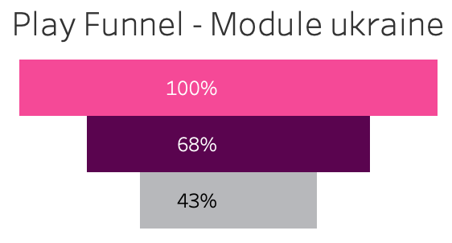
Did people actually watch?
Clicks
Start rate
Complete rate
The rates of starting and completing are high.
For TV starts is higher than the most popular iPlayer rail.
Completion is high, but content is mostly short (~3 mins)
people are clicking purposefully
Notes:
The rate of start and completion is high

Slide 20
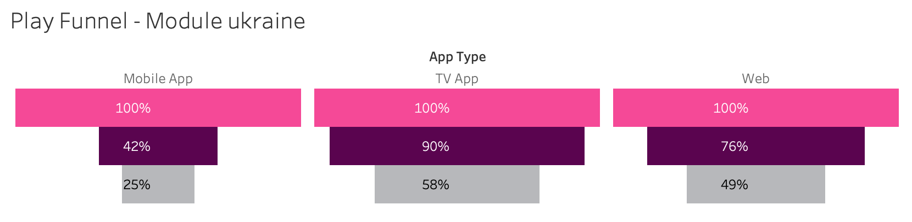
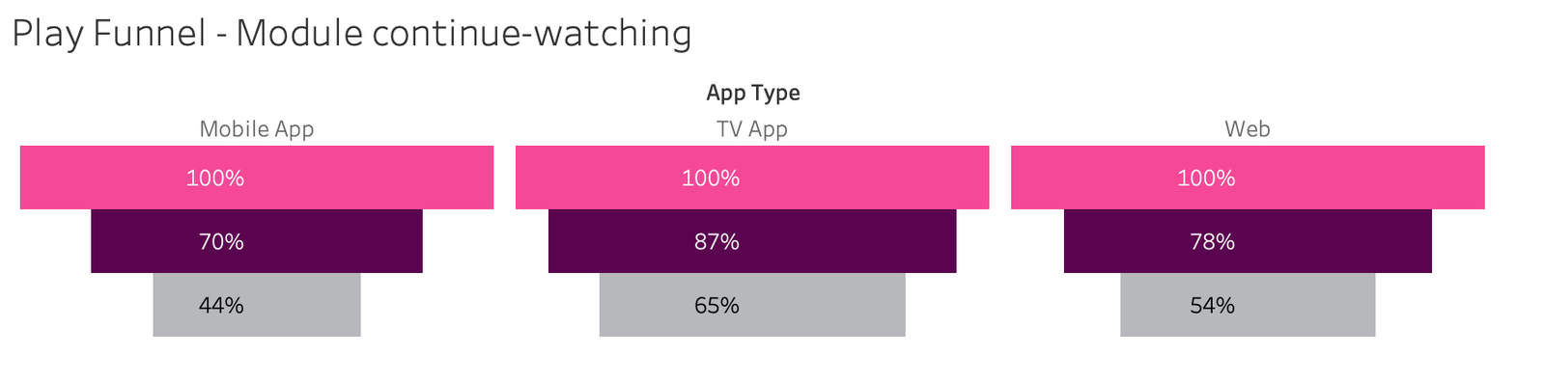
Did people actually watch?
Notes:
The rate of start and completion is high

Slide 21
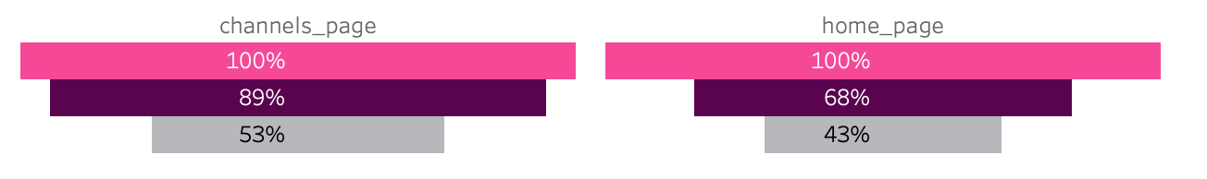
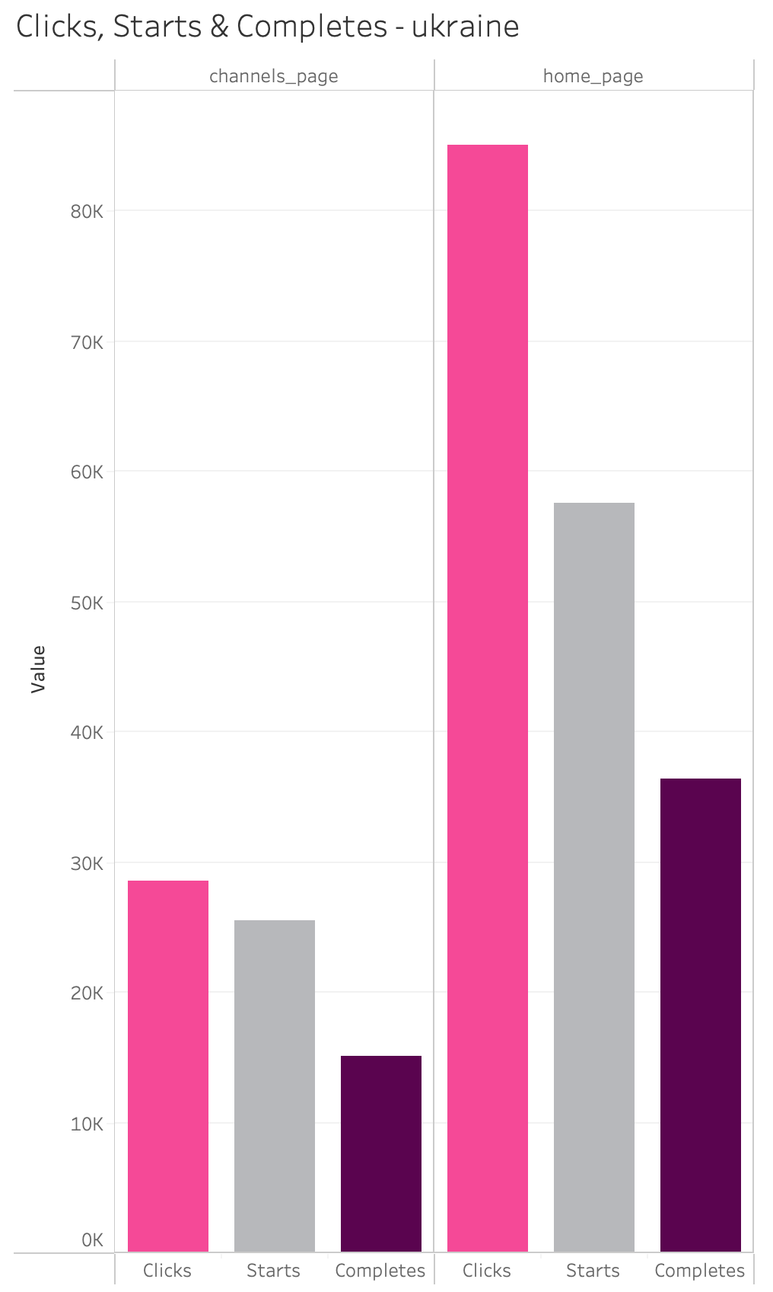
Was the content’s location important?
Content on the News channel was more likely to be completed.
But channel page traffic is still far lower than homepage.
Notes:
The rate of start and completion is high

Slide 22
Summary
150k users over 5 days
Slightly more male and older than typical.
More likely to be weekly users
Pros
Those who used it were highly engaged.
There is an appetite for this content.
Imagery is great.
Cons
The rail was too hard to find.
Not obvious that content was short form
Same content was everywhere
Core audience, no new/underserved users
Notes:
The rate of start and completion is high

